Slide 1
Introduction to Business Continuity in Azure SQL John Deardurff

Slide 2

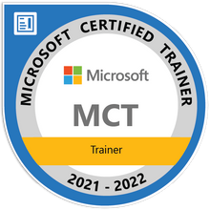


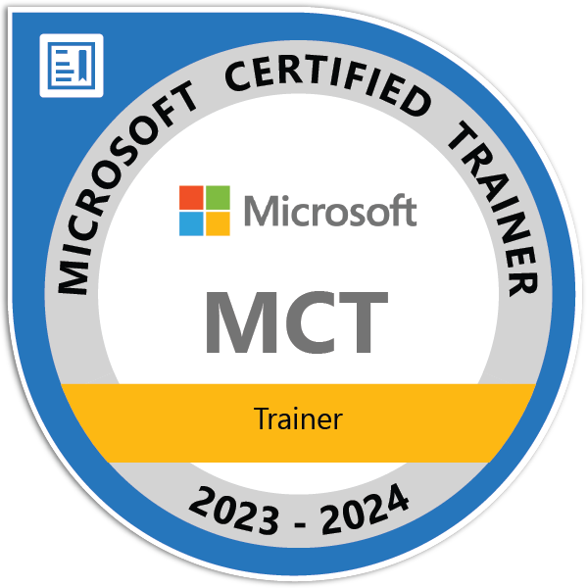

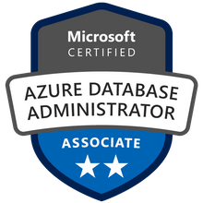

John Deardurff
Cloud Solution Architect (Global Delivery Team)
Microsoft Certified Trainer (2000 - Current)
MVP: Data Platform (2016 – 2018)
Email: John.Deardurff@Microsoft.com
Twitter: @SQLMCT
Website: www.SQLMCT.com
GitHub: github.com\SQLMCT

Slide 3
What does this session cover?
What is Business Continuity?
High Availability
Automated Backups
Geo-Replicas
Zone Redundancy
Service Tiers
Failover Groups
Notes:
In this session we will discuss What Accelerated Database Recovery is and how to enable the feature in SQL Server 2019. Then we will look at the Current Database Recovery process and some of the issues that occur based on the existing recovery design. Next, we walk through the four core components of ADR before walking through the new Accelerated Database Recovery Process. Finally, we will have a demonstration on all the awesomeness that is of ADR!

Slide 4
Recommended Links
Below you will find some additional information to help continue your learning journey.
Azure SQL documentation
Microsoft Learn: Azure Data
Try the Azure SQL Workshop
Azure SQL for Beginners
Physical security of Azure datacenters
Microsoft Azure Sustainability
Choosing the Correct Tools
Identify Correct Azure SQL SKU
Plan and manage costs for Azure SQL Database
Azure Database Migration Guides
Azure SQL Capacity Planning
Monitoring and performance tuning Azure SQL DB
Performance tuning guidance for Azure SQL DB
Automate Azure SQL Database indexes and statistics
Autoscaling Azure SQL Databases using Runbooks and Alerts
Cloud business continuity - disaster recovery
High availability - Azure SQL Database
Zone redundancy for Azure SQL Database
Restore a database from a backup in Azure SQL DB
Data Integrity checks in Azure SQL Database

Slide 5
What is Business Continuity in Azure SQL?

Slide 6

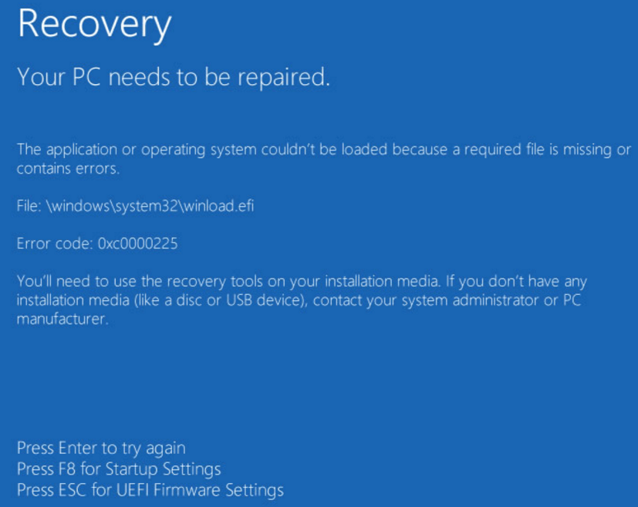


Business Continuity Problem
Mechanisms, Policies and Procedures that enable a business to continue operating in face of disruption.
Customer Error
Equipment Failures
Natural Disasters
Manmade Disasters
Customer deleted their data by mistake.
Hardware or other equipment failures
Flood, Hurricanes, Tornadoes, Earthquakes
Wars or major ecological accidents
Notes:
1 min Speaker instructions: Edit this slide to introduce the context of the session. Ideally this topic will focus on the customer’s problem domain, not any specific current or future technology.
Example from previous CAB events:
https://msit.microsoftstream.com/video/1fb40840-98dc-ac1e-0fd8-f1ed5f9b1a11?st=74
and
https://msit.microsoftstream.com/video/1fb40840-98dc-ac1e-0fd8-f1ed5f9b1a11?st=162

Slide 7
Availability vs High Availability vs Disaster Recovery
Availability
Every database comes with core resiliency and availability, that protects it against software or hardware failures.
Industry leading financially backed SLA of 99.99% availability.
High Availability
Continuous availability of the database provided through Zone Redundancy.
Automatic in region recovery from zonal hardware and software failures that’s transparent to applications.
Higher SLA of 99.995% availability.
Disaster Recovery
Ability to quickly recover the database from a catastrophic regional failure to provide business continuity.
Protect your business by maximizing application availability.
Customer configured database replicas or failover groups
Notes:
1 min Speaker instructions: Edit this slide to introduce the context of the session. Ideally this topic will focus on the customer’s problem domain, not any specific current or future technology.
Example from previous CAB events:
https://msit.microsoftstream.com/video/1fb40840-98dc-ac1e-0fd8-f1ed5f9b1a11?st=74
and
https://msit.microsoftstream.com/video/1fb40840-98dc-ac1e-0fd8-f1ed5f9b1a11?st=162

Slide 8
Automated Backups in Azure SQL

Slide 9
Backup and restore
Auto backups and Point in Time Restore (PITR)
Full Database backup once a week
Log Backups every 5-10 minutes
Backup files on Azure storage
Can be LRS, GRS, or ZRS
Backup Integrity checks
Restore to new database
Geo-restore of databases if primary region down
Restore backups of deleted databases
Differential Backups every 12-24 hours
Long-term retention (up to 10 years) of backups
Retention of a Full Database backup
Configurable for every week, month, or year
Backups retained for 7/35 days
Time
Now
-7 days
Self-service restore to a point in time
DB1
DB1
Notes:
By default, a full database backup is taken once a week, with log backups every 5-10 minutes, and differential backups every 12 hours. These backup files are stored in Azure Storage on read-access geo-redundant storage (RA-GRS). On an ongoing basis, the Azure SQL engineering team automatically tests the restore of automated databases backups of databases placed in logical servers and Elastic pools. For migrating to Azure SQL Managed Instance, an automatic initial backup with CHECKSUM of databases restored with the native RESTORE command or the Azure Database Migration Service is completed. Additionally, in Azure SQL Managed Instance, you can take a native COPY_ONLY backup and store it in Azure Blob storage.
Details for Backup Integrity Checks
On an ongoing basis, the Azure SQL Database engineering team automatically tests the restore of automated database backups of databases placed in logical servers and elastic database pools. (This testing isn't available in managed instance.) Upon point-in-time restore, databases also receive DBCC CHECKDB integrity checks.
Managed instance takes automatic initial backup with CHECKSUM of databases restored with the native RESTORE command or with Azure Data Migration Service after the migration is completed.
Restore to new database
You can deploy a new database also based on a backup
Notes on LTR backups
If you enable LTR policy, the weekly full backups are automatically copied to a different RA-GRS storage container. To meet various compliance requirements, you can select different retention periods for weekly, monthly, and/or yearly backups
LTR not supported on Hyperscale today
Current limits for LTR of backups for Managed Instance
Using long-term backup retention with an Azure SQL Database managed instances has the following limitations:
Limited public preview - This preview is only available to EA and CSP subscriptions and is subject to limited availability.
PowerShell only - There is currently no Azure portal support. LTR must be enabled using PowerShell.
Restore deleted databases
You cannot restore a deletion of a logical server or managed instance. The portal only allows you to restore a deleted database back to the deletion time. You need Powershell or REST to restore a backup of a deleted database from an earlier point of time based on backup retention.

Slide 10
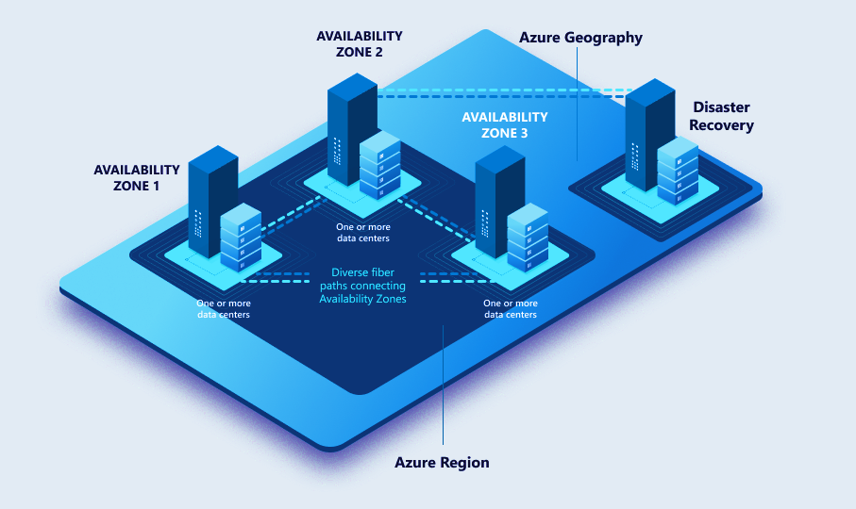
Backup storage redundancy
To enable high durability of backups several ways of replication are offered on instance creation.
The backups can be all located within
LRS: The same building (Local)
ZRS: Same region, different buildings (Zone)
GRS: Across paired regions (Geo)
Notes:
Locally redundant price = published price
Zone-redundant price = published price x 1.25
Geo-redundant price = published price x 2
Geo-zone-redundant price = published price x 3.4

Slide 11
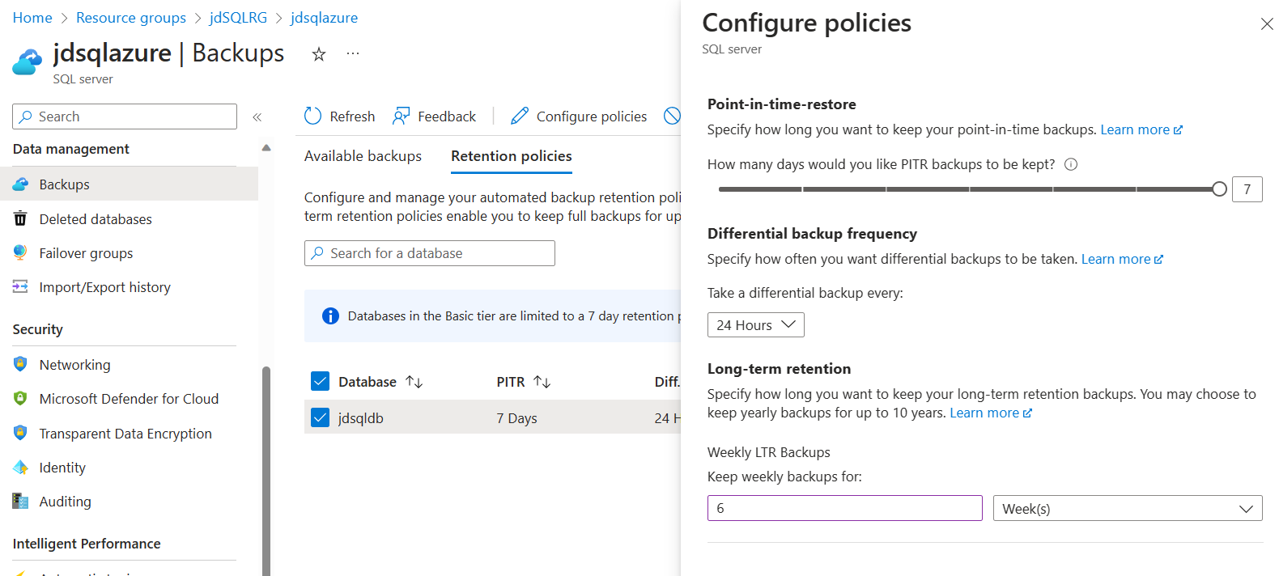
Setting Backup Policies

Slide 12
Demo Time

Slide 13
What are Service Tiers in Azure SQL?

Slide 14
Overview of Service Tiers
DTU based
Basic
Standard
Premium
vCore based
General purpose.
Business critical
Hyperscale
Managed Instance Service Tiers

Slide 15
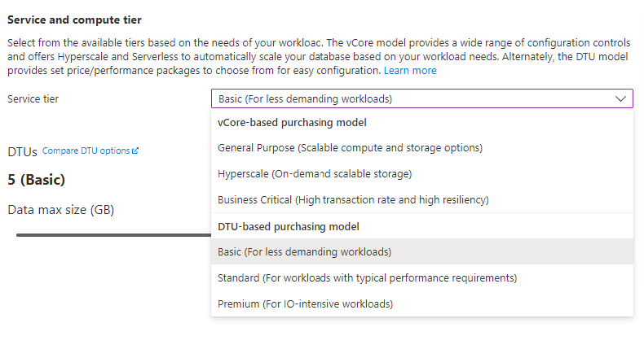
Changing Service Tiers

Slide 16
High Availability in Azure SQL

Slide 17

High Availability: General Purpose vs Business Critical
General Purpose (GP)
Business Critical (BC)
Separated Compute and Storage
Combined Compute and Storage
Azure Region
Azure Region
GW
GW
GW
GW
GW
Application
GW
Application
Control Ring
Control Ring
Secondary Replica
Secondary Replica
Primary Replica
Failover
Nodes with spare capacity
SSD, data, log
SSD, data, log
SSD, tempdb
Primary Replica
AlwaysON Availability Group
SSD, tempdb
SSD, data, log
Failover
Secondary Replica
Data and log files
Azure premium storage (LRS) data/log
SSD, data, log
Backup files
Azure standard storage
(RA-GRS, LRS, ZRS)
Backup files
Azure standard storage
(RA-GRS, LRS, ZRS)
Notes:
Premium availability is enabled in Premium tier of Azure SQL Database and it is designed for intensive workloads that cannot tolerate any performance impact due to the ongoing maintenance operations.
In the premium model, Azure SQL database integrates compute and storage on the single node. Both the SQL Server Database Engine process and underlying mdf/ldf files are placed on the same node with locally attached SSD storage providing low latency to your workload.
High availability is implemented using standard Always On Availability Groups. Every database is a cluster of database nodes with one primary database that is accessible for customer workload, and a few secondary processes containing copies of data. The primary node constantly pushes the changes to secondary nodes in order to ensure that the data is available on secondary replicas if the primary node crashes for any reason. Failover is handled by the SQL Server Database Engine – one secondary replica becomes the primary node and a new secondary replica is created to ensure enough nodes in the cluster. The workload is automatically redirected to the new primary node. Failover time is measured in milliseconds and the new primary instance is immediately ready to continue serving requests.

Slide 18
High Availability - General Purpose
Behaves like Failover Cluster Instance
Remote storage provides data redundancy
Backup files are in a different location with geo-redundancy
Failover decisions based on SQL and Service Fabric
Recovery time depends on spare capacity
Connectivity redirection built-in
Basic (DTU), Standard (DTU), General Purpose (vCore)
Azure Region
Application
GW
GW
GW
Control Ring
Primary Replica
Failover
Nodes with spare capacity
SSD, tempdb
SSD, tempdb
Data and log files
Azure premium storage (LRS) data/log
Backup files
Azure standard storage
(RA-GRS, LRS, ZRS)
Notes:
https://docs.microsoft.com/en-us/azure/sql-database/sql-database-high-availability
Standard availability refers to 99.99% SLA that is applied in Standard/Basic/General Purpose tiers. Availability is achieved by separation of compute and storage layers. In the standard availability model we have two layers:
A stateless compute layer that is running the sqlserver.exe process and contains only transient and cached data (for example – plan cache, buffer pool, column store pool). This stateless SQL Server node is operated by Azure Service Fabric that initializes process, controls health of the node, and performs failover to another place if necessary.
A stateful data layer with database files (.mdf/.ldf) that are stored in Azure Premium Storage Disks. Azure Storage guarantees that there will be no data loss of any record that is placed in any database file. Azure Storage has built-in data availability/redundancy that ensures that every record in log file or page in data file will be preserved even if SQL Server process crashes.
Whenever database engine or operating system is upgraded, or if some critical issue is detected in Sql Server process, Azure Service Fabric will move the stateless SQL Server process to another stateless compute node. Data in Azure Storage layer is not affected, and data/log files are attached to newly initialized SQL Server process. Expected failover time can be measured in seconds. This process guarantees 99.99% availability, but it might have some performance impacts on heavy workload that are running due to transition time and the fact the new SQL Server node starts with cold cache.

Slide 19
High Availability - Business Critical
High availability is achieved by replicating both compute and storage to additional nodes.
The cluster includes a single primary replica for read-write workloads, and up to three secondary replicas.
The failover is initiated by the Azure Service Fabric.
As an extra benefit, the premium availability model includes Read Scale-Out feature.
Premium (DTU) and Business Critical (vCore)
High availability is implemented using a technology like SQL Server Always On Availability Groups.
Azure Region
GW
GW
GW
Application
Control Ring
Secondary Replica
Secondary Replica
SSD, data, log
SSD, data, log
Primary Replica
AlwaysOn Availability Group
SSD, data, log
Failover
Secondary Replica
SSD, data, log
Backup files
Azure standard storage
(RA-GRS, LRS, ZRS)
Notes:
Premium availability is enabled in Premium tier of Azure SQL Database and it is designed for intensive workloads that cannot tolerate any performance impact due to the ongoing maintenance operations.
In the premium model, Azure SQL database integrates compute and storage on the single node. Both the SQL Server Database Engine process and underlying mdf/ldf files are placed on the same node with locally attached SSD storage providing low latency to your workload.
High availability is implemented using standard Always On Availability Groups. Every database is a cluster of database nodes with one primary database that is accessible for customer workload, and a few secondary processes containing copies of data. The primary node constantly pushes the changes to secondary nodes in order to ensure that the data is available on secondary replicas if the primary node crashes for any reason. Failover is handled by the SQL Server Database Engine – one secondary replica becomes the primary node and a new secondary replica is created to ensure enough nodes in the cluster. The workload is automatically redirected to the new primary node. Failover time is measured in milliseconds and the new primary instance is immediately ready to continue serving requests.

Slide 20
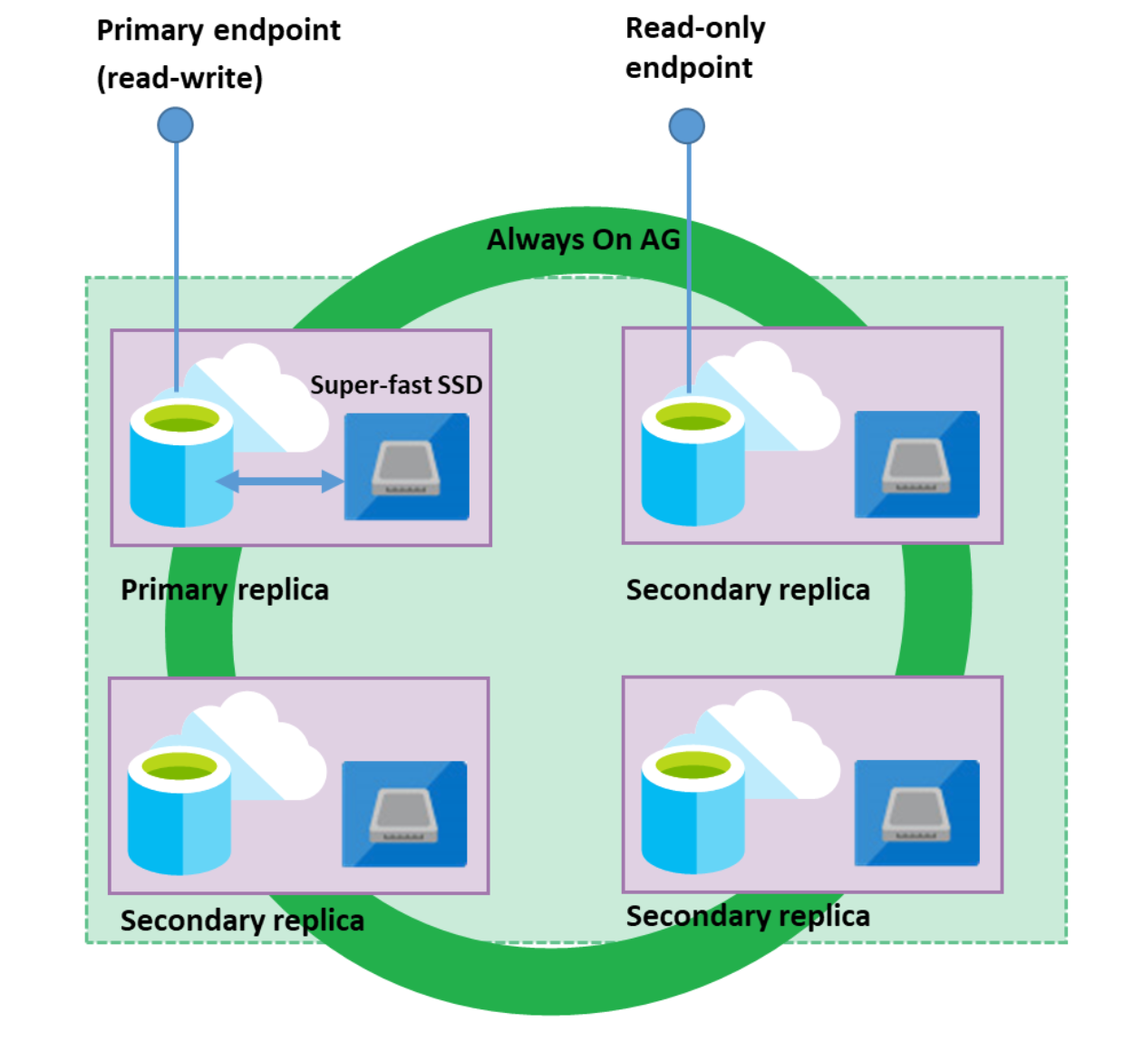
Read Scale-Out
Read Scale-Out redirects the read-only client connections to one of the ready-only replicas available instead of sharing the read-write replica.
Effectively isolate the read-only workload from the main read-write workload and doubles the compute capacity of the database or elastic pool at no additional charge.
This is ideal to scale-out for complex analytical workloads without affecting the primary OLTP workload.
Use ApplicationIntent=ReadOnly; to connect to the read-only replica.
Notes:
Each database in the Premium tier (DTU-based purchasing model) or in the Business Critical tier (vCore-based purchasing model) is automatically provisioned with several AlwaysON replicas to support the availability SLA.
These replicas are provisioned with the same compute size as the read-write replica used by the regular database connections.
The Read Scale-Out feature allows you to load balance SQL Database read-only workloads using the capacity of one of the read-only replicas instead of sharing the read-write replica.
This way the read-only workload will be isolated from the main read-write workload and will not affect its performance.
The feature is intended for the applications that include logically separated read-only workloads, such as analytics, and therefore could gain performance benefits using this additional capacity at no extra cost.

Slide 21
Zone Redundancy in Azure SQL?

Slide 22
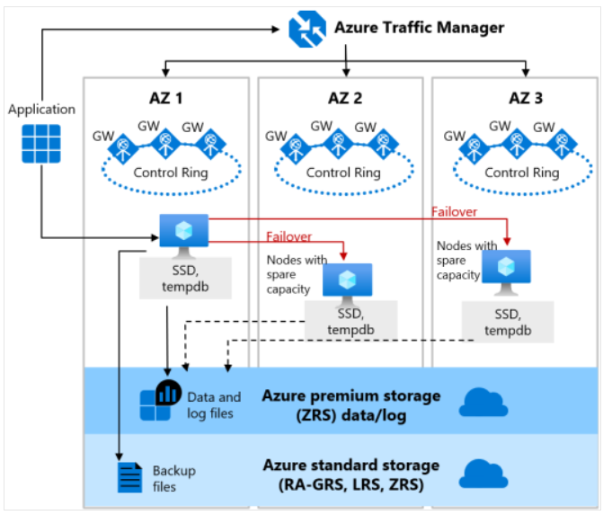
Zone redundant configuration – General Purpose
SQL Database can place different replicas of the Business-Critical database to different availability zones in the same region.
The routing is controlled by Azure Traffic Manager (ATM).
The zone redundant databases have replicas in different datacenters with some distance between them, the increased network latency may impact the performance.
Zone redundant configurations are available in the Premium, Business Critical, General Purpose and Hyperscale Service Tiers
Notes:
Zone-redundant availability ensures your data is spread across three Azure Availability Zones in the Primary Region. Each availability zone is separate physical location with independent power, cooling and networking.
Zone redundant configurations are available in the Premium, Business Critical, General Purpose and Hyperscale Service Tiers. But not available for Basic and Standard Service tiers of the DTU based purchasing model. Each Serivce tier implements Zone-redundant availability differently.
In General purpose service tier, zone-redundant is available for both serverless and provisioned compute for databases in vCore purchasing model.
By default, the quorum-set replicas for the local storage configurations are created in the same datacenter. With the introduction of Azure Availability Zones, you have the ability to place the different replicas in the quorum-sets to different availability zones in the same region. To eliminate a single point of failure, the control ring is also duplicated across multiple zones as three gateway rings (GW). The routing to a specific gateway ring is controlled by Azure Traffic Manager (ATM). Because the zone redundant configuration does not create additional database redundancy, the use of Availability Zones in the Premium or Business Critical service tiers is available at no extra cost. By selecting a zone redundant for database, you can make your General-purpose databases resilient to a much larger set of failures, including catastrophic datacenter outages, without any changes of the application logic.
Because the zone redundant quorum-set has replicas in different datacenters with some distance between them, the increased network latency may increase the commit time and thus impact the performance of some OLTP workloads. You can always return to the single-zone configuration by disabling the zone redundancy setting. This process is a size of data operation and is similar to the regular service level objective (SLO) update. At the end of the process, the database or pool is migrated from a zone redundant ring to a single zone ring or vice versa.

Slide 23
Zone redundant configuration – Premium and Business Critical
Zone redundant configurations are available in the Premium, Business Critical, General Purpose and Hyperscale Service Tiers.
By default, the cluster of nodes for the premium availability model is created in the same datacenter.
SQL Database can place different replicas of the Business-Critical database to different availability zones in the same region.
The routing is controlled by Azure Traffic Manager (ATM).
The zone redundant databases have replicas in different datacenters with some distance between them, the increased network latency may impact the performance.
Azure Traffic Manager
Application
AZ 1
AZ 2
AZ 3
GW
GW
GW
GW
GW
GW
GW
GW
GW
Control Ring
Control Ring
Control Ring
Secondary Replica
Secondary Replica
SSD, data, log
Always ON Availability Group
SSD, data, log
Primary Replica
Failover
Secondary Replica
SSD, data, log
SSD, data, log
Backup files
Azure standard storage
(RA-GRS, LRS, ZRS)
Notes:
By default, the quorum-set replicas for the local storage configurations are created in the same datacenter. With the introduction of Azure Availability Zones, you have the ability to place the different replicas in the quorum-sets to different availability zones in the same region. To eliminate a single point of failure, the control ring is also duplicated across multiple zones as three gateway rings (GW). The routing to a specific gateway ring is controlled by Azure Traffic Manager (ATM). Because the zone redundant configuration does not create additional database redundancy, the use of Availability Zones in the Premium or Business Critical service tiers is available at no extra cost. By selecting a zone redundant for database, you can make your Premium or Business Critical databases resilient to a much larger set of failures, including catastrophic datacenter outages, without any changes of the application logic. You can also convert any existing Premium, Business Critical, General Purpose and Hyperscale Service tier databases or pools to the zone redundant configuration.
It is not available in the Basic and standard service tiers of the DTU-based purchasing model.
Because the zone redundant quorum-set has replicas in different datacenters with some distance between them, the increased network latency may increase the commit time and thus impact the performance of some OLTP workloads. You can always return to the single-zone configuration by disabling the zone redundancy setting. This process is a size of data operation and is similar to the regular service level objective (SLO) update. At the end of the process, the database or pool is migrated from a zone redundant ring to a single zone ring or vice versa.

Slide 24
Demo Time

Slide 25
Disaster Recovery in Azure SQL?

Slide 26
Active Geo-replication
Service levels | Basic, standard, premium Self service
Readable secondaries | Up to 4
Regions available | Any Azure region
Replication | Automatic, asynchronous
Manageability tools | REST API, PowerShell, or Azure Portal
Recovery time objective (RTO) | <1 hour
Recovery point objective | <5 minutes
Failover | On demand
Up to 4 secondaries
Notes:
https://learn.microsoft.com/en-us/azure/azure-sql/database/active-geo-replication-overview?view=azuresql
Active geo-replication is designed as a business continuity solution that allows the application to perform quick disaster recovery in case of a data center scale outage. If geo-replication is enabled, the application can initiate failover to a secondary database in a different Azure region. Up to four secondaries are supported in the same or different regions, and the secondaries can also be used for read-only access queries. The failover must be initiated manually by the application or the user. After failover, the new primary has a different connection end point.
If you are using active geo-replication and for any reason your primary database fails, or simply needs to be taken offline, you can initiate failover to any of your secondary databases. When failover is activated to one of the secondary databases, all other secondaries are automatically linked to the new primary.
Active geo-replication leverages the Always On technology of SQL Server to asynchronously replicate committed transactions on the primary database to a secondary database using snapshot isolation. Auto-failover groups provide the group semantics on top of active geo-replication but the same asynchronous replication mechanism is used. While at any given point, the secondary database might be slightly behind the primary database, the secondary data is guaranteed to never have partial transactions. Cross-region redundancy enables applications to quickly recover from a permanent loss of an entire datacenter or parts of a datacenter caused by natural disasters, catastrophic human errors, or malicious acts.
If your secondary replica is used only for disaster recovery (DR) and doesn't have any read or write workloads, you can designate the replica as standby to save on licensing costs. But there are some limitations for example
Only one secondary database replica can be designated for standby.
The serverless compute tier isn't supported. Standby replica can't be enabled if the primary or secondary database is in the serverless compute tier.
The DTU purchasing model isn't supported. You can enable a standby replica for databases using the vCore purchasing model only.
The Hyperscale service tier isn't supported. Only databases in the General Purpose and Business Critical service tiers can be designated for standby.
For more detail check the documentation page
https://learn.microsoft.com/en-us/azure/azure-sql/database/standby-replica-how-to-configure?view=azuresql&tabs=azure-portal

Slide 27
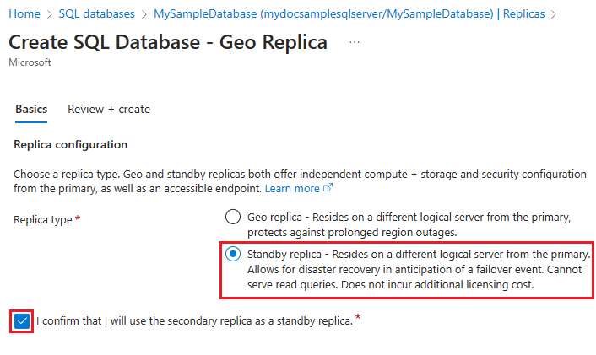
Stand-by Replicas
A secondary database replica that is used only for disaster recovery. Cannot have any workloads running on it, or applications connecting to it.
Provides you with the number of vCores licensed to the primary database at no extra charge under the failover rights benefit.
Available for General Purpose or Business Critical service tiers.
Save on licensing costs up to 40%. You're still billed for the compute and storage that the secondary database uses.
Notes:
Configure license-free standby replica - Azure SQL Database | Microsoft Learn
When a secondary database replica is used only for disaster recovery, and doesn't have any workloads running on it, or applications connecting to it, you can save on licensing costs by designating the database as a standby replica. When a secondary database is designated for standby, Microsoft provides you with the number of vCores licensed to the primary database at no extra charge under the failover rights benefit in the product licensing terms. You're still billed for the compute and storage that the secondary database uses.
You can designate a replica for standby when you configure a new active geo-replication replication, or you can convert an existing replica to be standby.
While active geo-replication supports adding four secondary replicas, you can only designate one secondary database replica for standby. Failover groups support one secondary database replica per primary database, and it can be either readable, or standby.
During planned or unplanned failover, the standby replica becomes the new primary and starts to incur regular vCore licensing costs while the original primary becomes the new standby secondary, and stops incurring vCore licensing costs.
Cost benefit

Slide 28
Failover groups extend geo-replication
Enables geo-replication for a group of databases within a server.
Automatically or manually failover a group of databases.
Available for all service tiers.
Configure the auto-failover policy that best meets your application needs.
Usage of and listener end-points.
DNS record is automatically updated.
alias
mydb.myserver.windows.database.net
Notes:
Auto-failover groups is an extension of active geo-replication. It is designed to manage the failover of multiple geo-replicated databases simultaneously using an application initiated failover or by delegating failover to be done by the SQL Database service based on a user defined criteria. It allows you to automatically recover multiple related databases in a secondary region after a catastrophic failure or other unplanned event that results in full or partial loss of the SQL Database service’s availability in the primary region. Additionally, you can use the readable secondary databases to offload read-only query workloads. Because auto-failover groups involve multiple databases, these databases must be configured on the primary server. Both primary and secondary servers for the databases in the failover group must be in the same subscription. t's possible to deploy your failover group across subscriptions by using the -PartnerSubscriptionId parameter in Azure Powershell starting with Az.SQL 3.11.0. Auto-failover groups support replication of all databases in the group to only one secondary server in a different region.
If you are using auto-failover groups to manage database recovery and any outage that impacts one or several of the databases in the group results in automatic failover. You can configure the auto-failover policy that best meets your application needs, or you can opt out and use manual activation. In addition, auto-failover groups provide read-write and read-only listener end-points that remain unchanged during failovers. Whether you use manual or automatic failover activation, failover switches all secondary databases in the group to primary. After the database failover is completed, the DNS record is automatically updated to redirect the end-points to the new region.

Slide 29
Active geo-replication vs auto-failover groups
 | Geo-replication (Database) | Auto-failover groups (Server)
Automatic failover | No | Yes
Fail over multiple databases simultaneously | No | Yes
Update connection string after failover | Yes | No
Managed instance supported | No | Yes
Can be in same region as primary | Yes | No
Multiple replicas | Yes | No
Supports read-scale | Yes | Yes
Notes:
Layout: Desktop Only
Anna lead in to architecture.
Anna: Remember to mention Geo-replication now available for Hyperscale in Public Preview

Slide 30
Demo Time

Slide 31
Questions?

Slide 32
